Slide 1


Java File class
File class is an abstract representation of file and directory pathnames.
The File class in the Java IO API gives you access to the underlying file system.
The File object represents the actual file/directory on the disk.
Using the File class we can:
Check if a file or directory exists.
Create a directory if it does not exist.
Read the length of a file.
Rename or move a file.
Delete a file.
Check if path is file or directory.
Read list of files in a directory.
The File only gives you access to the file and file system meta data. If you need to read or write the content of files, you should do so using either FileInputStream, FileOutputStream or RandomAccessFile.

Slide 2
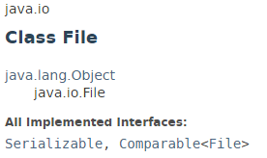
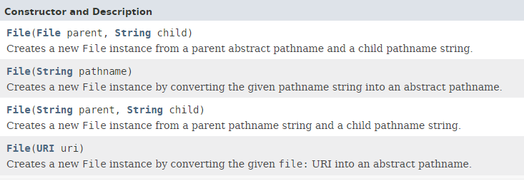
Java File class

Slide 3
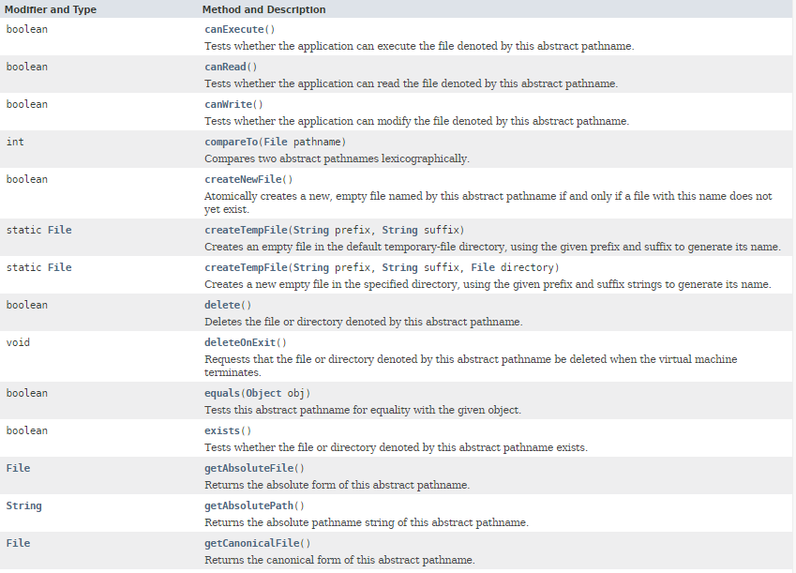
Java File class

Slide 4
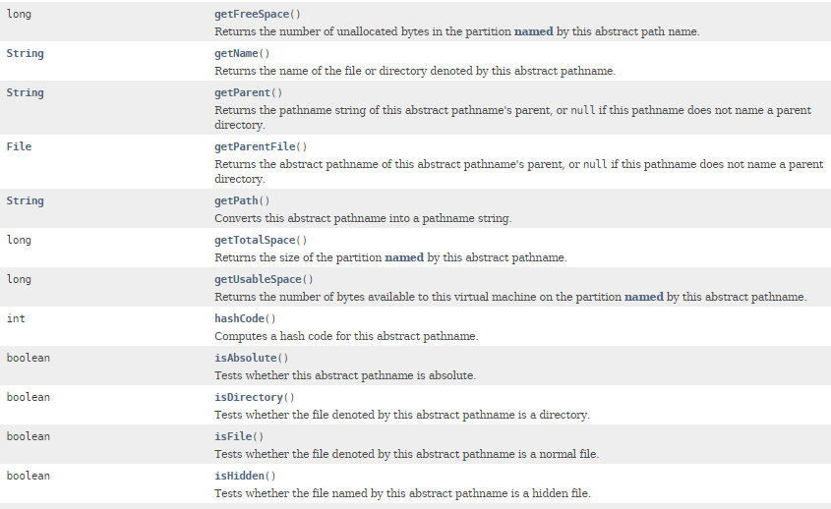
Java File class

Slide 5
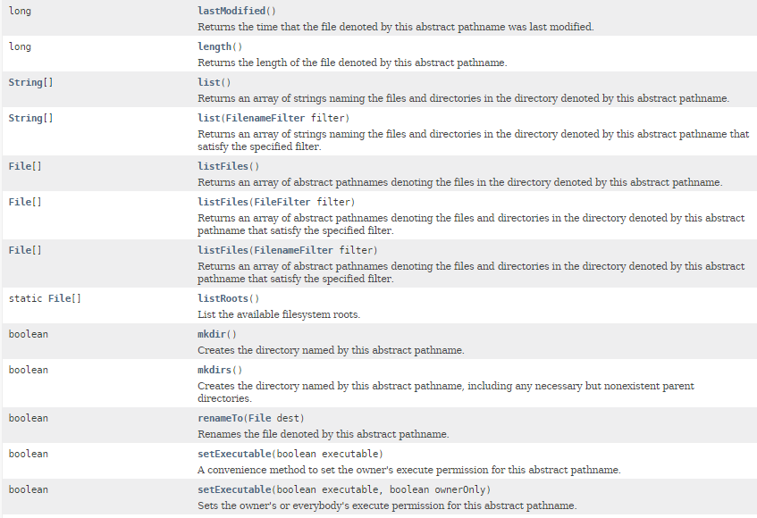
Java File class

Slide 6
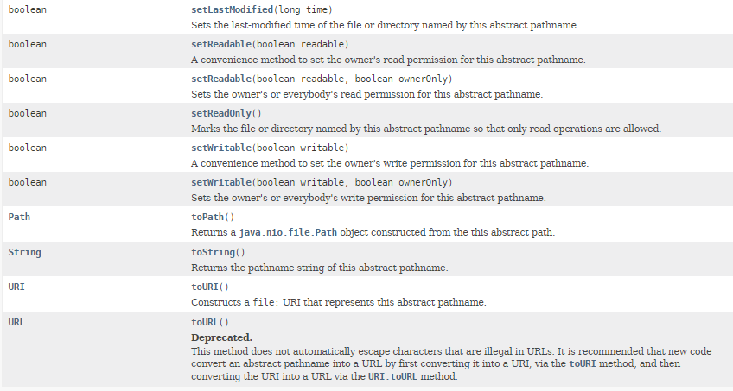
Java File class

Slide 7
Java File class
https://docs.oracle.com/javase/8/docs/api/index.html?java/io/File.html

